Slide 1
Invite Welcome Connect
You Had Me at Hello
Abi Moon
St John’s Tallahassee, FL

Slide 2
THANK YOU For being here
Why did you choose this workshop?

Slide 3
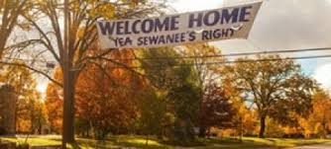
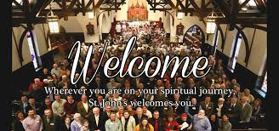
WHY I am here and leading this workshop

Slide 4
What made you feel welcome in your current worship space?

Slide 5
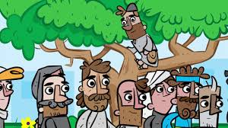
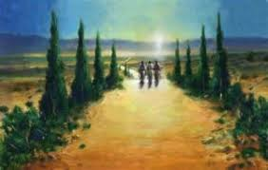
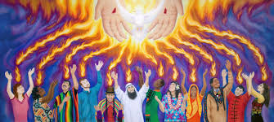
Where is ‘Welcome’ in the Bible?
Palm Sunday
Zaccheus
Emmaus
Pentecost

Slide 6
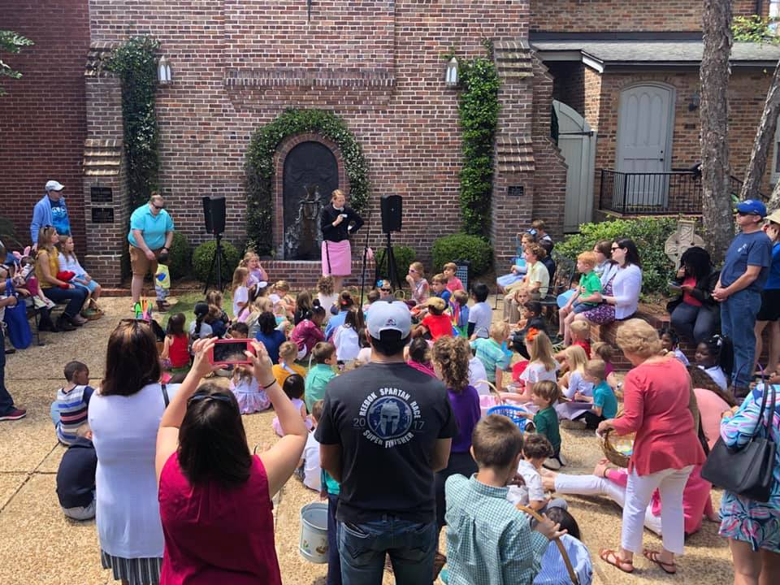
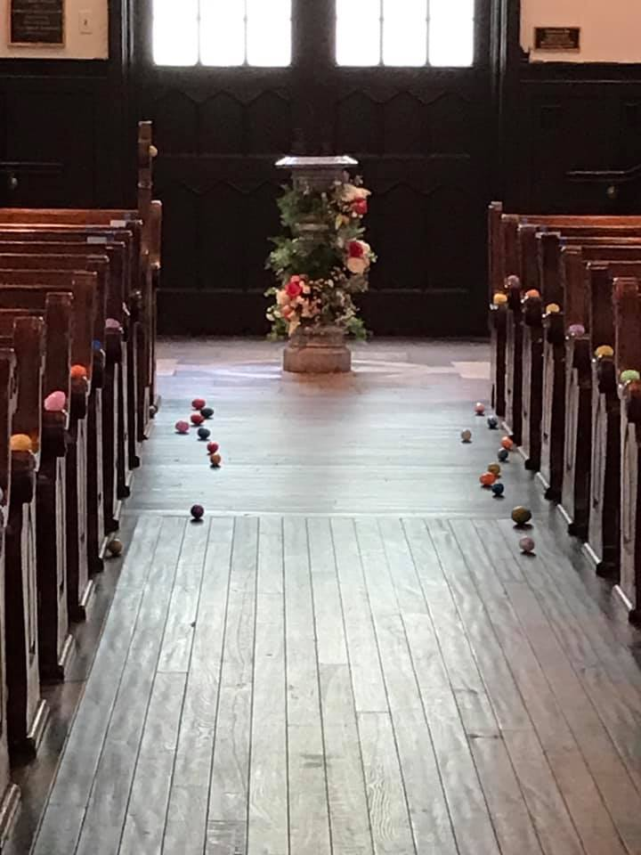
Share what we do well
EASTER

Slide 7
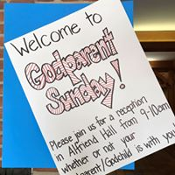
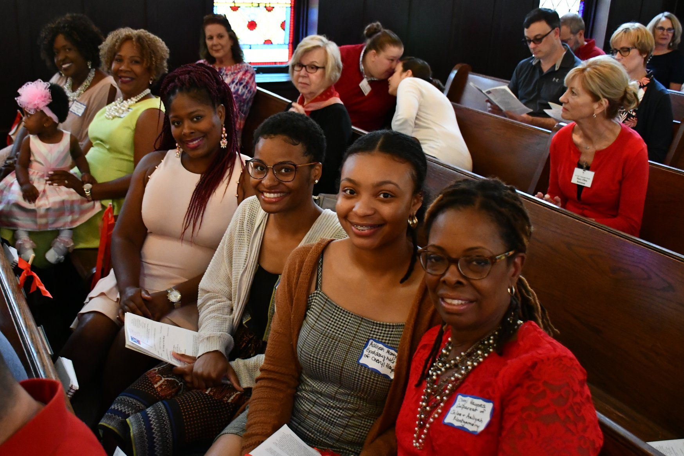
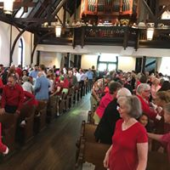
Godparent Sunday

Slide 8
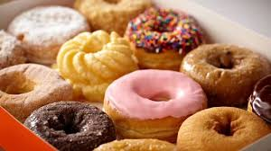
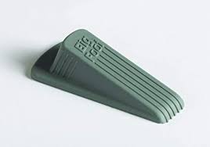
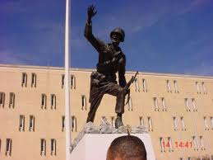
HOW we say welcome matters
Donuts
Follow me!
Greeter or doorstop?

Slide 9
How do we invite?
Website
Paper
Signage on campus
GREETERS
Do we walk with people
Where is parking
Where is the nursery?

Slide 10
Speak with LOVE
YOU LOVE JESUS
YOU WANT OTHERS TO LOVE JESUS
You might be the ONLY form of Jesus they see that day!

Slide 11
THANK YOU for coming!

