Slide 1

The Role of Spiritual Gifts in Connecting
Canon Mary M. MacGregor &
Sally Mahon
Invite*Welcome*Connect* Summit
Beecken Center, Sewanee, TN
Thursday, June 13, 2019

Slide 2

Icebreaker Story Sharing
Recall the all time worst job you have done at a church. What was it?
Was the problem with a relationship or the actual work?
Why did you really not like doing it? How long did you do it?

Slide 3


Slide 4


Slide 5
When you hear the term ‘spiritual gifts’ what immediately comes to mind?

Slide 6
Why do you think the Episcopal Church has been reluctant to embrace spiritual gifts?

Slide 7
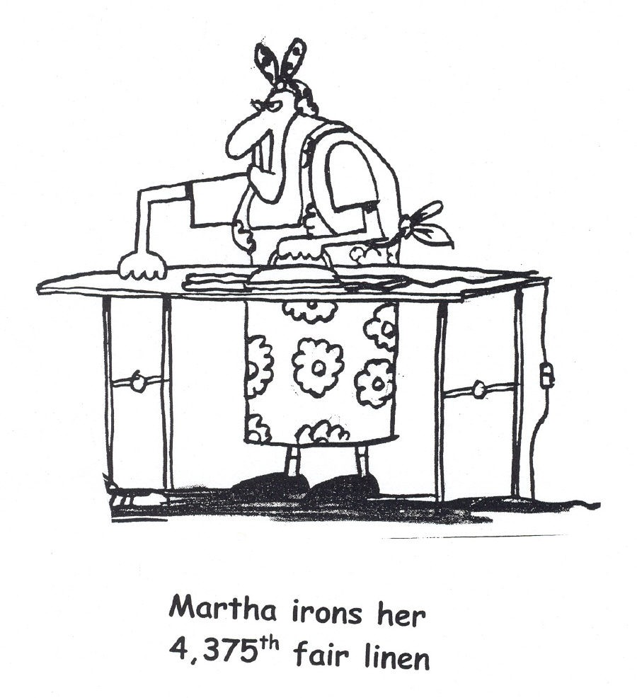

Slide 8
The Common Cold of the Soul
To sinful patterns of behavior that never get confronted and changed,
Abilities and gifts that never get cultivated and deployed –
Until weeks become months
And months turn into years,
And one day you’re looking back on a life of
Deep intimate gut-wrenchingly honest conversations you never had;
Great bold prayers you never prayed,
Exhilarating risks you never took,
Sacrificial gifts you never offered
Lives you never touched,
And you’re sitting in a recliner with a shriveled soul,
And forgotten dreams,
And you realize there was a world of desperate need,
And a great God calling you to be part of something bigger then yourself –
You see the person you could have become but did not;
You never followed your calling.
You never got out of the boat
Gregg Levoy, quoted in If You Want to Walk on Water, You’ve Got to Get Out of the Boat by John Ortberg

Slide 9
The Mission of the Episcopal Church
“…To restore all people to unity with God and each other in Christ.”
The Catechism, BCP, p. 855

Slide 10
It’s About Relationship
It’s about….
One’s personal relationship with God through Christ Jesus
One’s relationship with other people in Christian community
Christian community’s relationship with the world around them, near and far, through sharing the love of Christ Jesus
relate (ri-layt)-to narrate (to tell a story), to tell in detail
Oxford American Dictionary

Slide 11
The Apostle Paul Instructs About the Church…
Just as each of us has one body with many members, and these members do not all have the same function, so in Christ we who are many form one body, and each member belongs to all the others. We have different gifts, according to the grace given us….
Romans 12: 4-6

Slide 12
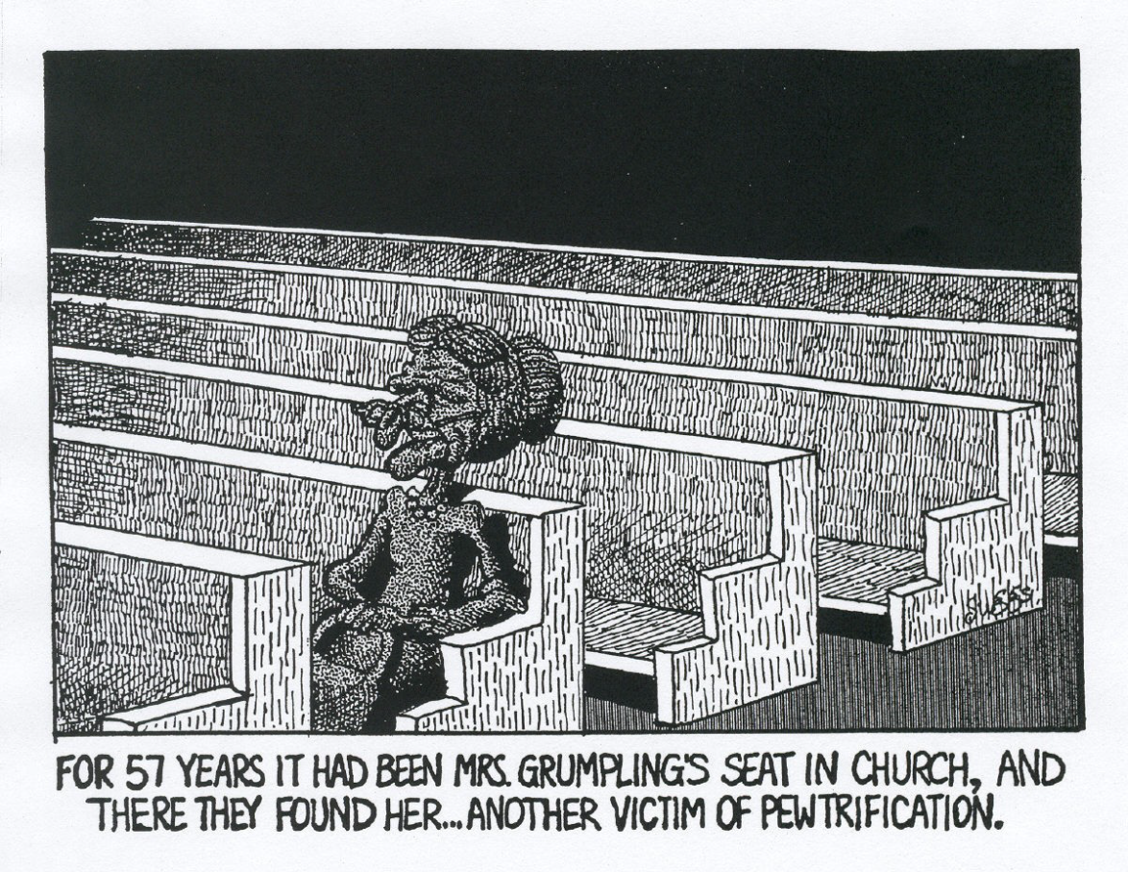
Who’s In the Pews?

Slide 13
The Apostle Paul Goes On To Say…
There is a variety of gifts but always the same spirit; there are all sorts of service to be done, but always to the same Lord; working in all sorts of different ways in different people, it is the same God who is working in all of them. The particular way in which the spirit is given to each person is for a good purpose…
Now you together are Christ’s body: but each of you is a different part in the Church…
1 Corinthians 12:4-7, 27

Slide 14
27 Spiritual Gifts from Scripture
Apostles
Administration
Artistic ability
Celibacy
Craftsmanship
Discernment of Spirits
Exhortation
Faith
Giving
Healing
Hospitality
Instrumental Music
Intercession
Interpretation of Tongues
Knowledge
Martyrdom
Mercy
Miracles
Missionary
Pastor
Prophecy
Serving
Teaching
Tongues
Vocal Music
Wisdom

Slide 15

The Body of Christ
Who has what God given gift and why does the church need to
help individuals discern their gifts?
What is your church doing to help people
discern and use their spiritual gifts?

Slide 16
Good Resources for Spiritual Gifts Assessment
Invite*Welcome*Connect* website! www.invitewelcomeconnect.com
Check out “Tool Kit” and Resources for Connect
Three Resources I like:
1. www.freeshapetest.com or other Rick Warren S.H.A.P.E resources
2. NEW: “Life in the Spirit” the Rev. Frank Allen, St. David’s Episcopal Church. Ft. Wayne, PA www.stdavidschurch.org/education/online-learning-resources
3. ELCA Gifts Assessment Tool – Google ‘spiritual gifts assessment elca’
and www.elca.org comes up, hit, goes directly to the survey

Slide 17
Discovering My Ministry through S.H.A.P.E.
My Ministry is determined by my
MAKEUP.
What God made me to BE determines what He intends for me to DO. I will understand the purpose I was created for when I understand the kind of person I am.
God is consistent in His plan for each of our lives. He would not give us inborn talents and temperaments, spiritual gifts, and all sorts of life experiences and then not use them! By reviewing and studying these factors, we can discover the ministry has for us... the unique way God intends for us to serve Him.

Slide 18
DISCOVERING HOW GOD HAS SHAPED ME FOR MINISTRY
HOW HAS GOD SHAPED ME?
I was shaped for a purpose.
I am unique!
I am wonderfully complex.
"What right do you have, a human being, to cross-examine God? The pot has no right to say to the potter: Why did you make me this shape? A potter can do what he likes with the clay!"
Romans 9:20-21

Slide 19
MY S.H.A.P.E. WILL DETERMINE MY MINISTRY
SPIRITUAL GIFTS
What am I gifted to do?
HEART
What do I love to do?
ABILITIES
What natural talents and skills do I have?
PERSONALITY
Where does my personality best suit me to serve?
EXPERIENCES
What experiences have I had?

Slide 20

One of the Best Resources…
www.womenoftheelca.org/filebin/pdf/resources/SpiritualGifts.pdf

Slide 21
Why I Recommend It
Comprehensive Resource
Fully explains multiple uses of the packet including self, group, retreat, workshop usage
  20 spiritual gifts defined, aligns well with Episcopal ethos/theology
  Contains two applied Bible studies
  Includes assessment, cluster of gifts grid
  Spiritual Gift Descriptions Include:
  Definition
  People with this gift are usually…
  Cautions for people with this gift…
  Biblical references

Slide 22
Sample Description
Evangelism: The spiritual gift that moves the individual to reach nonbelievers in such a way that they are baptized and become active disciples in the Christian community.
People with this gift are usually: sincere, candid, respected, influential, spiritual, confident, commitment oriented.
Cautions for people with this gift: remembering that the Holy Spirit, not guilt, is the motivator in a person’s decision for Christ; needing to listen carefully, because the same approach is not appropriate for everyone.
Biblical references: Matthew 28: 16-20, Ephesians 4:11-16, 2Timothy 4:1-5

Slide 23
Why Spiritual Gifts Workshops?
Objectives:
To have newcomers and as many members as possible gain insight into their spiritual gifts to better align the ministries they undertake with their giftedness.
To gain this information about these persons and record it in the church’s data base to be known when specific ministry opportunities arise.

Slide 24
A Sample Spiritual Gifts Workshop…
Backstory….
St. Christopher Episc. Church, League City, TX
New Rector
New Invite*Welcome*Connect* emphasis
Open and individual invitations
Co-designed and led by rector, myself
3 hours
Personal follow up with each participant

Slide 25
Spiritual Gifts Workshop Outline
Contact me for more information:
Mary M.MacGregor
consultmmm@verizon.net
C:281-381-9113

Slide 26
Your Ideas, Questions, Comments

